Slide 1
AVL Trees
CMSC 420

Slide 2
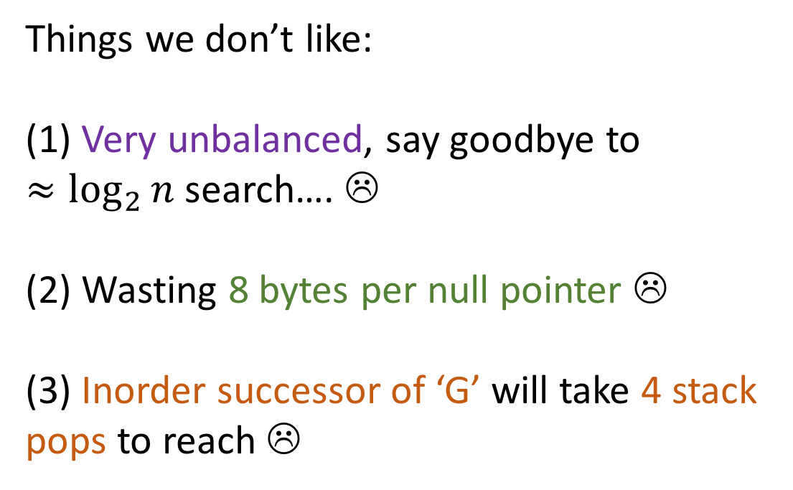
The hated tree
M
Things we don’t like: (1) Very unbalanced, say goodbye to $≈\log_{2}{n}$ search…. ☹
(2) Wasting 8 bytes per null pointer ☹
(3) Inorder successor of ‘G’ will take 4 stack pops to reach ☹
A
X
x
E
x
x
x
F
x
G
x
x

Slide 3
The hated Tree, v2
M
Things we don’t like: (1) Very unbalanced, say goodbye to $≈\log_{2}{n}$ search…. ☹
(2) Wasting 8 bytes per null pointer ☹
(3) Inorder successor of ‘G’ will take 4 stack pops to reach ☹
A
X
x
E
x
F
G

Slide 4

The hated Tree, v2
M
Things we don’t like: (1) Very unbalanced, say goodbye to $≈\log_{2}{n}$ search…. ☹
(2) Wasting 8 bytes per null pointer ☹
(3) Inorder successor of ‘G’ will take 4 stack pops to reach ☹
A
X
x
E
x
F
G

Slide 5
Binary Search Trees: Insertion Order
We are given this BST:
6
2
11
0
4
5

Slide 6

Binary Search Trees: Insertion Order
Which among the following insertion sequences is the one that produced this BST?
6
11, 6, 2, 0, 4, 5
2
11
2, 6, 11, 4, 0, 5
0
4
6, 11, 2, 0, 5, 4
5
6, 11, 2, 0, 4, 5

Slide 7
Binary Search Trees: Insertion Order
Which among the following insertion sequences is the one that produced this BST?
6
11, 6, 2, 0, 4, 5
2
11
2, 6, 11, 4, 0, 5
0
4
6, 11, 2, 0, 5, 4
5
6, 11, 2, 0, 4, 5

Slide 8
Binary Search Trees: Insertion Order
Which among the following insertion sequences is the one that produced this BST?
6
11, 6, 2, 0, 4, 5
2
11
2, 6, 11, 4, 0, 5
0
5
6, 11, 2, 0, 5, 4
4
6, 11, 2, 0, 4, 5

Slide 9
Binary Search Trees: Insertion Order
Which among the following insertion sequences is the one that produced this BST?
6
11, 6, 2, 0, 4, 5
2
11
2, 6, 11, 4, 0, 5
Notice that both of these orderings lead to very unbalanced BSTs ☹
0
5
6, 11, 2, 0, 5, 4
4
6, 11, 2, 0, 4, 5

Slide 10
Take-home message #1: “As if we didn’t know this already”
For the same set of elements, two different insertion orders can lead to radically different binary search trees.

Slide 11

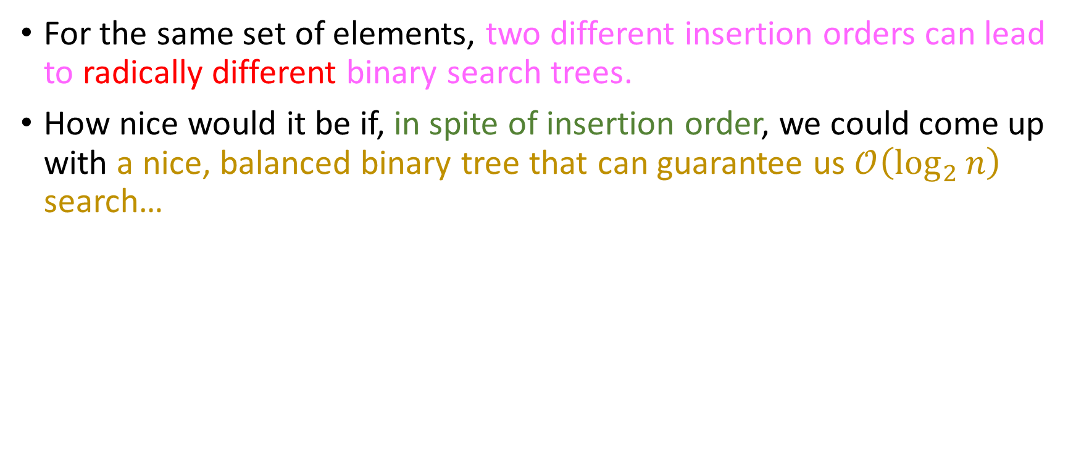
Take-home message #1: “As if we didn’t know this already”
For the same set of elements, two different insertion orders can lead to radically different binary search trees.
How nice would it be if, in spite of insertion order, we could come up with a nice, balanced binary tree that can guarantee us $𝒪\left(\log_{2}{n}\right)$ search…

Slide 12

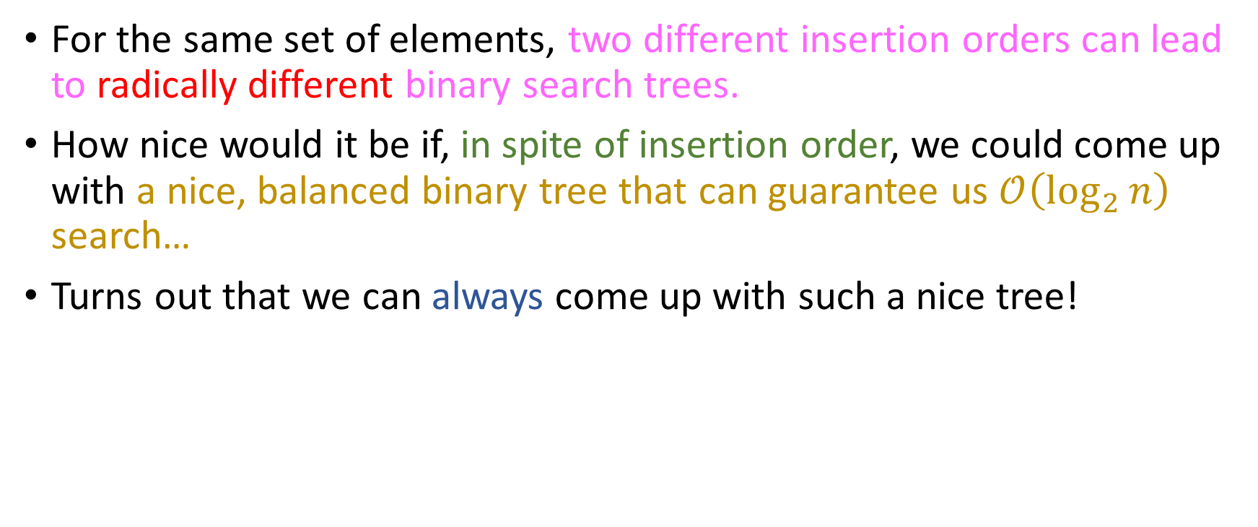
Take-home message #1: “As if we didn’t know this already”
For the same set of elements, two different insertion orders can lead to radically different binary search trees.
How nice would it be if, in spite of insertion order, we could come up with a nice, balanced binary tree that can guarantee us $𝒪\left(\log_{2}{n}\right)$ search…
Turns out that we can always come up with such a nice tree!

Slide 13

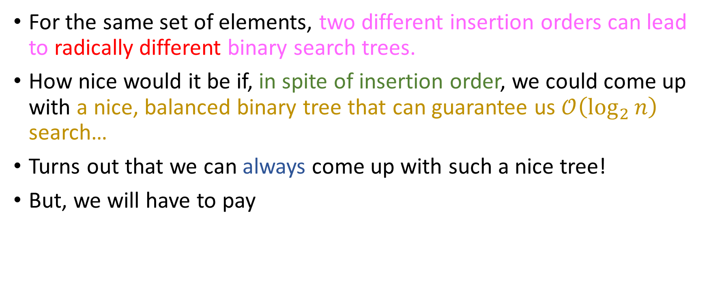
Take-home message #1: “As if we didn’t know this already”
For the same set of elements, two different insertion orders can lead to radically different binary search trees.
How nice would it be if, in spite of insertion order, we could come up with a nice, balanced binary tree that can guarantee us $𝒪\left(\log_{2}{n}\right)$ search…
Turns out that we can always come up with such a nice tree!
But, we will have to pay

Slide 14
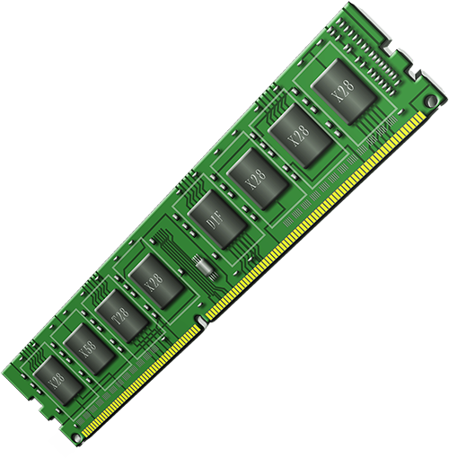
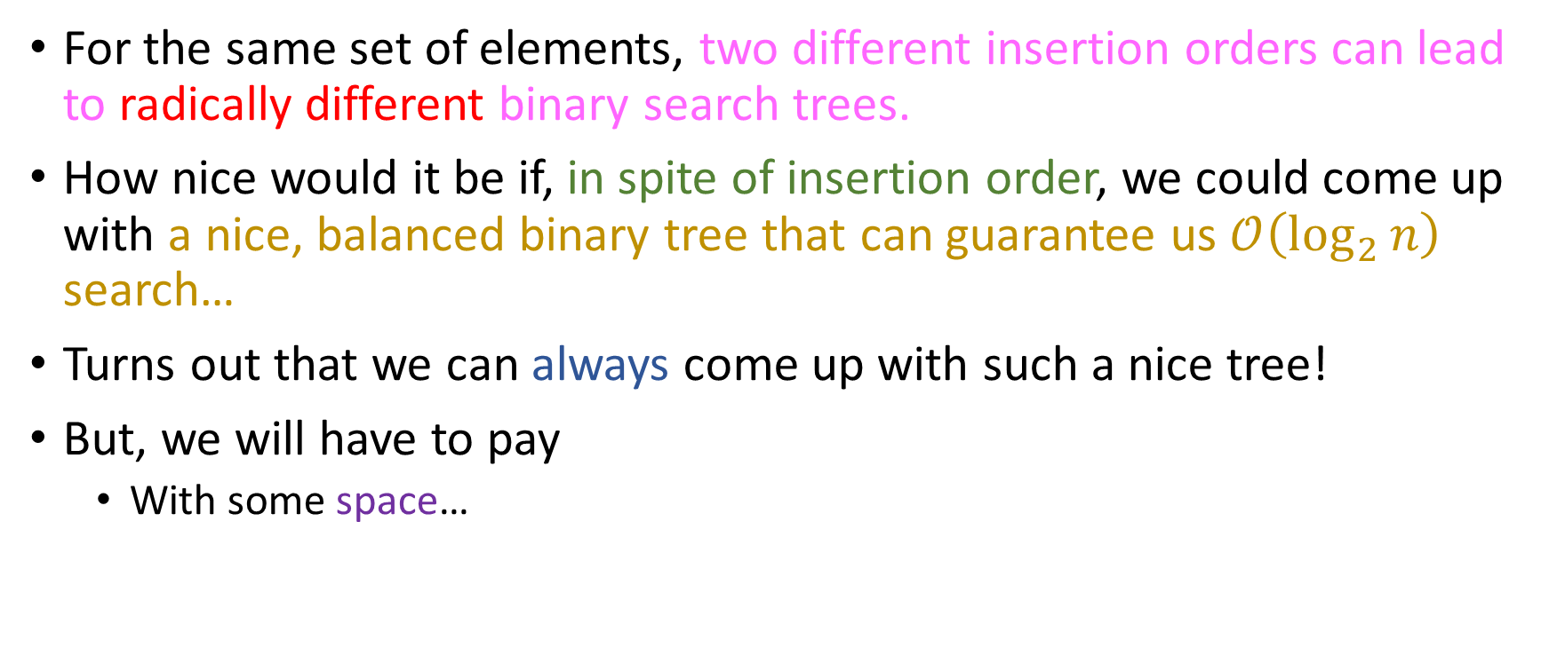
Take-home message #1: “As if we didn’t know this already”
For the same set of elements, two different insertion orders can lead to radically different binary search trees.
How nice would it be if, in spite of insertion order, we could come up with a nice, balanced binary tree that can guarantee us $𝒪\left(\log_{2}{n}\right)$ search…
Turns out that we can always come up with such a nice tree!
But, we will have to pay
With some space…

Slide 15
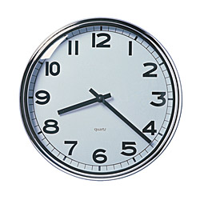
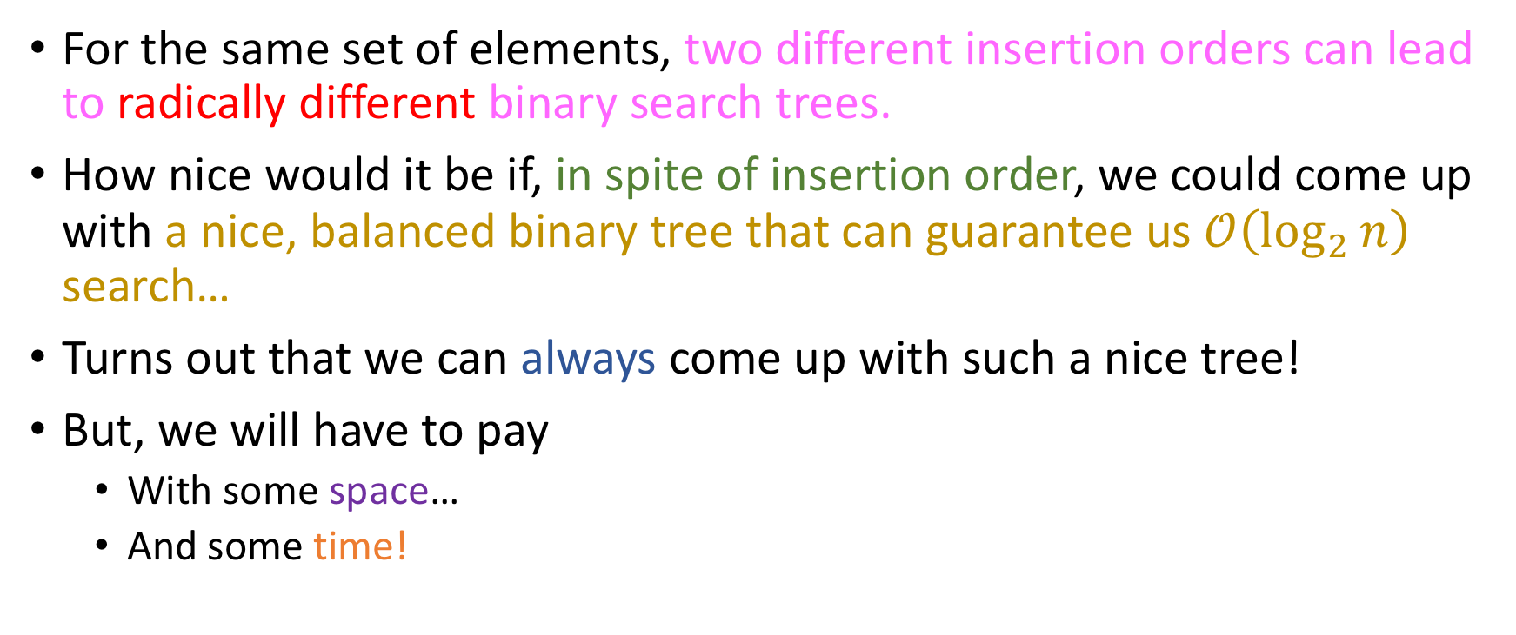
Take-home message #1: “As if we didn’t know this already”
For the same set of elements, two different insertion orders can lead to radically different binary search trees.
How nice would it be if, in spite of insertion order, we could come up with a nice, balanced binary tree that can guarantee us $𝒪\left(\log_{2}{n}\right)$ search…
Turns out that we can always come up with such a nice tree!
But, we will have to pay
With some space…
And some time!

Slide 16
AVL Trees
Short for Georgy Adelson-Velsky and Evgenii Landis, Soviet Mathematicians.
Key idea: We will allow any subtree of our binary tree to be unbalanced by at most one level!
Notes:
Explain to the students what “unbalanced” means.

Slide 17
AVL Trees
Short for Georgy Adelson-Velsky and Evgenii Landis, Soviet Mathematicians.
Key idea: We will allow any subtree of our binary tree to be unbalanced by at most one level!
Vote:
OK
NOT OK
Notes:
Explain to the students what “unbalanced” means.

Slide 18
AVL Trees
Short for Georgy Adelson-Velsky and Evgenii Landis, Soviet Mathematicians.
Key idea: We will allow any subtree of our binary tree to be unbalanced by at most one level!
Vote:
OK
NOT OK

Slide 19
AVL Trees
Short for Georgy Adelson-Velsky and Evgenii Landis, Soviet Mathematicians.
Key idea: We will allow any subtree of our binary tree to be unbalanced by at most one level!
Vote:
OK
NOT OK
Fully balanced everywhere
OK

Slide 20
AVL Trees
Short for Georgy Adelson-Velsky and Evgenii Landis, Soviet Mathematicians.
Key idea: We will allow any subtree of our binary tree to be unbalanced by at most one level!
Vote:
OK
NOT OK
Fully balanced everywhere
OK

Slide 21
AVL Trees
Short for Georgy Adelson-Velsky and Evgenii Landis, Soviet Mathematicians.
Key idea: We will allow any subtree of our binary tree to be unbalanced by at most one level!
Vote:
OK
NOT OK
Imbalance of one level, still ok!
Fully balanced everywhere
OK
OK

Slide 22
AVL Trees
Short for Georgy Adelson-Velsky and Evgenii Landis, Soviet Mathematicians.
Key idea: We will allow any subtree of our binary tree to be unbalanced by at most one level!
Vote:
OK
NOT OK
Imbalance of one level, still ok!
Fully balanced everywhere
OK
OK

Slide 23
AVL Trees
Short for Georgy Adelson-Velsky and Evgenii Landis, Soviet Mathematicians.
Key idea: We will allow any subtree of our binary tree to be unbalanced by at most one level!
Vote:
Imbalance of one level, still ok!
OK
NOT OK
No imbalance!
Imbalance of one level, still ok!
Fully balanced everywhere
OK
OK
OK

Slide 24
AVL Trees
Short for Georgy Adelson-Velsky and Evgenii Landis, Soviet Mathematicians.
Key idea: We will allow any subtree of our binary tree to be unbalanced by at most one level!
Vote:
Imbalance of one level, still ok!
OK
NOT OK
No imbalance!
Imbalance of one level, still ok!
Fully balanced everywhere
OK
OK
OK

Slide 25
AVL Trees
Short for Georgy Adelson-Velsky and Evgenii Landis, Soviet Mathematicians.
Key idea: We will allow any subtree of our binary tree to be unbalanced by at most one level!
Vote:
Imbalance of one level, still ok!
Imbalance of two levels, not ok ☹
OK
NOT OK
No imbalance!
Imbalance of one level, still ok!
Fully balanced everywhere
OK
OK
OK
NOT OK

Slide 26
AVL Trees
Short for Georgy Adelson-Velsky and Evgenii Landis, Soviet Mathematicians.
Key idea: We will allow any subtree of our binary tree to be unbalanced by at most one level!
Vote:
Imbalance of one level, still ok!
Imbalance of two levels, not ok ☹
OK
NOT OK
No imbalance!
Imbalance of one level, still ok!
Fully balanced everywhere
But we can do something about it ☺
OK
OK
OK
NOT OK

Slide 27
Are these trees “AVL-balanced”?
(a)
(b)
(c)
(d)
(e)
(f)

Slide 28

Are these trees “AVL-balanced”?
(a)
(b)
(c)
(d)
All subtrees have a difference of at most 1 unit of height… (or 1 level).
(e)
(f)

Slide 29

Are these trees “AVL-balanced”?
(a)
(b)
(c)
(d)
Some imbalances detected!
(e)
(f)

Slide 30
Imbalance calculation
What’s with this “imbalance” metric?
Maybe we can “see” it in these examples, but we need a robust formalization so that we can write some code that detects it!

Slide 31
Imbalance calculation
What’s with this “imbalance” metric?
Maybe we can “see” it in these examples, but we need a robust formalization so that we can write some code that detects it!
Definitions:

Slide 32
Imbalance calculation
What’s with this “imbalance” metric?
Maybe we can “see” it in these examples, but we need a robust formalization so that we can write some code that detects it!
Definitions:
Height of empty tree = -1.

Slide 33
Imbalance calculation
What’s with this “imbalance” metric?
Maybe we can “see” it in these examples, but we need a robust formalization so that we can write some code that detects it!
Definitions:
Height of empty tree = -1.
Height of a non-empty-tree = max {Height(Left), Height(Right)} + 1

Slide 34
Imbalance calculation
What’s with this “imbalance” metric?
Maybe we can “see” it in these examples, but we need a robust formalization so that we can write some code that detects it!
Definitions:
Height of empty tree = -1.
Height of a non-empty-tree = max {Height(Left), Height(Right)} + 1
Corollary: height of a stub tree = 0

Slide 35
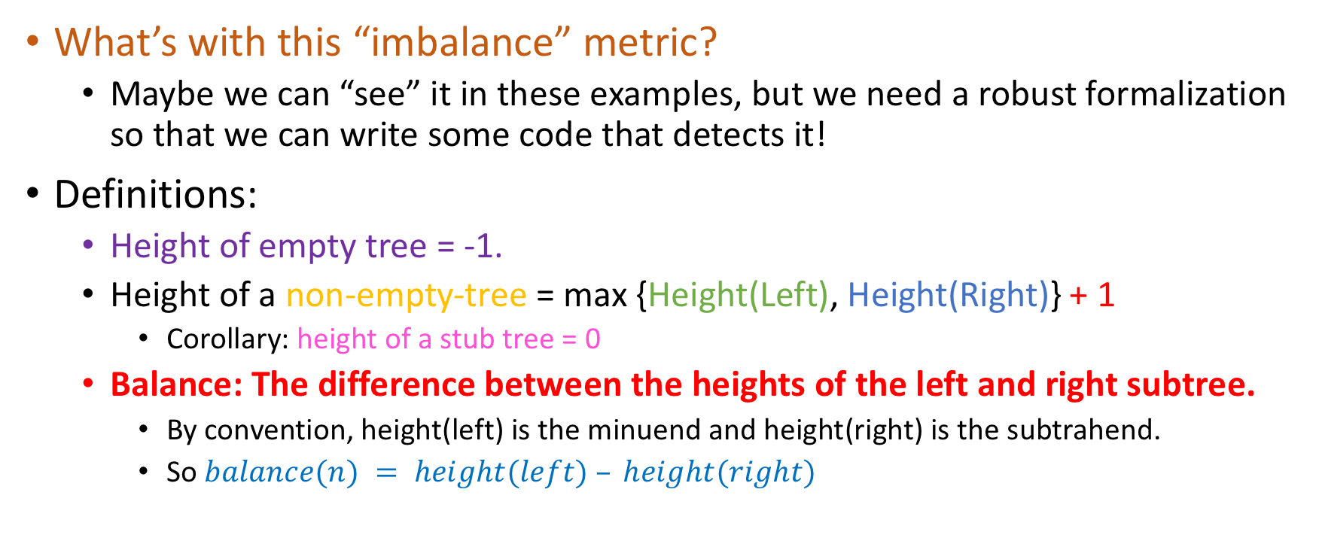
Imbalance calculation
What’s with this “imbalance” metric?
Maybe we can “see” it in these examples, but we need a robust formalization so that we can write some code that detects it!
Definitions:
Height of empty tree = -1.
Height of a non-empty-tree = max {Height(Left), Height(Right)} + 1
Corollary: height of a stub tree = 0
Balance: The difference between the heights of the left and right subtree.
By convention, height(left) is the minuend and height(right) is the subtrahend.
So $balance(n) = height(left) – height(right)$

Slide 36
Quizzes for you:
Which among the following is an invalid value for the balance of any given AVL tree node?
1
-1
0
-2

Slide 37
Quizzes for you:
Which among the following is an invalid value for the balance of any given AVL tree node?
1
-1
0
-2
-2 means that the height of the right subtree of the node is height(left) + 2.
+2 means that the height of the left subtree of the node is height(right) + 2
Both are unacceptable from an AVL perspective.

Slide 38
Rotations
To preserve the balance conditions in an AVL tree, we will use some elementary operations called rotations
Those will consist of some pointer assignments and height updates. They will locally change the structure of the tree such that:
The binary search tree condition is satisfied
The AVL balance condition is restored where violated.
We will see how those work with some examples.

Slide 39
Rotations
Insert 20 in the tree
20
No imbalance yet!
x
x

Slide 40
Rotations
Insert 10 in the tree
20
No imbalance yet!
10
x
x
x

Slide 41
Rotations
Insert 5 in the tree
20
No imbalance y… oh.
10
x
5
x
x
x

Slide 42
Rotations
Insert 15 in the tree
balance = height(left) – height(right) = 2
20
Imbalance at root node ☹
10
x
height = 1
height = -1
5
x
x
x

Slide 43
Rotations
20
x
Right rotation about root!
10
10
5
x
5
20
x
x
x
x
x
x

Slide 44

Rotations
20
No imbalance!
BST condition satisfied!
x
Right rotation about root!
10
10
5
x
5
20
x
x
x
x
x
x

Slide 45
Rotations
20
No imbalance!
BST condition satisfied!
x
Right rotation about root!
10
10
5
x
5
20
x
x
x
x
x
x
Process:
Left child of 20 (the previous root) becomes 10’s right child (null).
Right child of 10 becomes 20 (the previous root). This makes 10 the new root.
Left child of 10 remains as is (no change)

Slide 46
Rotations
Now let’s assume that instead of 5 we had inserted 15.
20
10
x
x
15
x
x

Slide 47
Rotations
Now let’s assume that instead of 5 we had inserted 15.
balance = height(left) – height(right) = 2
20
20
Same imbalance at root node ☹
10
x
height = 1
height = -1
x
15
x
x

Slide 48
Rotations
Now let’s assume that instead of 5 we had inserted 15.
balance = height(left) – height(right) = 2
20
20
Same imbalance at root node ☹
10
x
height = 1
Claim: There’s a single right rotation that solves this imbalance for us.
height = -1
x
15
True
(where?)
False (why?)
x
x

Slide 49

Rotations
Now let’s assume that instead of 5 we had inserted 15.
balance = height(left) – height(right) = 2
20
20
Same imbalance at root node ☹
10
x
height = 1
Claim: There’s a single right rotation that solves this imbalance for us.
height = -1
x
15
True
(where?)
False (why?)
x
x
See next slide for short analysis….

Slide 50
Rotations
If we do a right rotation about the root…
20
10
x
x
15
x
x

Slide 51
Rotations
If we do a right rotation about the root… That solves exactly nothing ☹
10
20
x
20
10
x
x
x
15
15
From balance = 2 to balance = -2 ☹
x
x
x
x

Slide 52
“Complex” rotations
But what if we do a left rotation about 10…
20
10
x
x
15
x
x

Slide 53
“Complex” rotations
But what if we do a left rotation about 10…
20
10
x
x
15
x
x

Slide 54
“Complex” rotations
But what if we do a left rotation about 10…
20
20
x
15
x
10
Left (10)
10
x
x
15
x
x
x
x

Slide 55

“Complex” rotations
But what if we do a left rotation about 10… followed by a right rotation about 20?
20
20
x
15
x
10
Left (10)
10
x
x
15
x
x
x
x

Slide 56
“Complex” rotations
But what if we do a left rotation about 10… followed by a right rotation about 20?
20
20
15
x
15
x
10
Left (10)
Right (20)
10
20
10
x
x
15
x
x
x
x
x
x
x
x

Slide 57
“Complex” rotations
But what if we do a left rotation about 10… followed by a right rotation about 20?
20
20
15
x
15
x
10
Left (10)
Right (20)
10
20
10
x
x
15
x
x
x
x
x
x
x
x
This is also known as a L-R rotation about the root ☺

Slide 58
“Complex” rotations
But what if we do a left rotation about 10… followed by a right rotation about 20?
20
20
15
x
15
x
10
Left (10)
Right (20)
10
20
10
x
x
15
x
x
x
x
x
x
x
x
This is also known as a L-R rotation about the root ☺

Slide 59
The 4 cases of rotations
“Zig-Zig”
“Zig-Zag”
“Zag-Zig”
“Zag-Zag”

Slide 60
The 4 cases of rotations
“Zig-Zig”
“Zig-Zag”
“Zag-Zig”
“Zag-Zag”
R
L-R
R-L
L

Slide 61
Insertions
Insertions happen as in a normal BST, only we have to re-balance any subtree that is imbalanced.

Slide 62
Insertions
Insertions happen as in a normal BST, only we have to re-balance any subtree that is imbalanced.
Top-down part is like a normal BST. “Less than” goes left, bigger than or equal goes right.

Slide 63
Insertions
Insertions happen as in a normal BST, only we have to re-balance any subtree that is imbalanced.
Top-down part is like a normal BST. “Less than” goes left, bigger than or equal goes right.
But bottom-up requires that we rebalance the tree whenever an imbalance is detected!

Slide 64
Insertions
Insertions happen as in a normal BST, only we have to re-balance any subtree that is imbalanced.
Top-down part is like a normal BST. “Less than” goes left, bigger than or equal goes right.
But bottom-up requires that we rebalance the tree whenever an imbalance is detected!
Since an insertion into a subtree is the only thing that could have caused an imbalance, we have to check for imbalances after some recursive insertions.

Slide 65
Insertions
Insertions happen as in a normal BST, only we have to re-balance any subtree that is imbalanced.
Top-down part is like a normal BST. “Less than” goes left, bigger than or equal goes right.
But bottom-up requires that we rebalance the tree whenever an imbalance is detected!
Since an insertion into a subtree is the only thing that could have caused an imbalance, we have to check for imbalances after some recursive insertions.
This means that we cannot implement AVL Trees tail-recursively. ☹

Slide 66
Insertion Example
Insert 9
9

Slide 67
Insertion Example
Insert 5
9
5

Slide 68
Insertion Example
Insert 1
9
5
1

Slide 69

Insertion Example
Insert 1
9
5
1
Imbalance!

Slide 70

Insertion Example
Insert 1
9
5
1
At which node do we detect the imbalance?

Slide 71

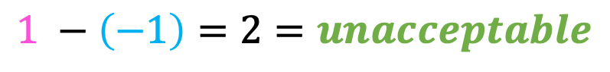
Insertion Example
Insert 1
9
Height of 1
5
Height of -1
1
The root!
$$1 −\left(−1\right)=2=unacceptable$$

Slide 72
Insertion Example
Insert 1
5
1
9
Right rotation!

Slide 73
Insertion Example
Insert 10
5
1
9
10

Slide 74
Insertion Example
Insert 7
5
1
9
7
10

Slide 75
Insertion Example
Insert 7
5
Still ok at all levels! ☺
1
9
7
10

Slide 76
Insertion Example
Insert 8
5
1
9
7
10
8

Slide 77
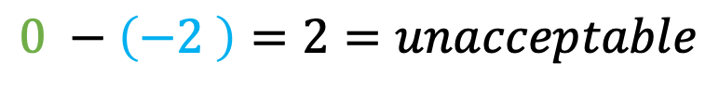
Insertion Example
Imbalance detected at root again!
Insert 8
Height of 0
5
Height of 2
1
9
7
10
$$0 −\left(−2 \right)=2=unacceptable$$
8

Slide 78

Insertion Example
Imbalance detected at root again!
Insert 8
Height of 0
5
Height of 2
1
9
What rotation should I perform?
7
10
$$0 −\left(−2 \right)=2=unacceptable$$
8

Slide 79
Figuring out the rotation
5
9
1
Left about (5)
9
5
10
7
10
1
7
8
8

Slide 80
Figuring out the rotation
5
9
1
Left about (5)
9
5
10
7
10
1
7
8
This just switched our imbalance to the left ☹ (from “negative” to “positive”)
8

Slide 81
Figuring out the rotation
5
1
9
7
10
8

Slide 82
Figuring out the rotation
5
1
9
7
10
8

Slide 83
Figuring out the rotation
5
1
9
7
10
8

Slide 84
Figuring out the rotation
5
5
1
9
Right about (9)
1
7
7
10
9
8
10
8

Slide 85
Figuring out the rotation
5
5
1
9
Right about (9)
1
7
7
10
9
8
10
8

Slide 86
Figuring out the rotation
5
5
7
1
9
Right about (9)
1
7
Left about (5)
5
9
9
7
10
1
8
10
8
10
8

Slide 87
Figuring out the rotation
5
5
7
1
9
Right about (9)
1
7
Left about (5)
5
9
9
7
10
1
8
10
8
10
8
R-L rotation about (5)

Slide 88

Figuring out the rotation
5
5
7
1
9
Right about (9)
1
7
Left about (5)
5
9
9
7
10
1
8
10
8
10
8
R-L rotation about (5)
This works perfectly ☺

Slide 89
How to figure out correct rotation?
Back to our original insertion of 8; how do we figure out whether we need an L or an RL rotation about the root?
5
1
9
7
10
8

Slide 90
How to figure out correct rotation?
Back to our original insertion of 8; how do we figure out whether we need an L or an RL rotation about the root?
5
Check right subtree; while it’s true that it is an AVL (sub)-tree, is it “left heavy” or “right heavy”?
1
9
7
10
8

Slide 91
How to figure out correct rotation?
Back to our original insertion of 8; how do we figure out whether we need an L or an RL rotation about the root?
5
Check right subtree; while it’s true that it is an AVL (sub)-tree, is it “left heavy” or “right heavy”?
1
9
This one is left-heavy; we need a R-L rotation.
7
10
8

Slide 92
How to figure out correct rotation?
Back to our original insertion of 8; how do we figure out whether we need an L or an RL rotation about the root?
5
Check right subtree; while it’s true that it is an AVL (sub)-tree, is it “left heavy” or “right heavy”?
1
9
While in this situation we would just need a left rotation.
7
10
11

Slide 93
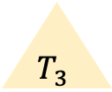
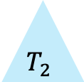
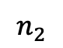
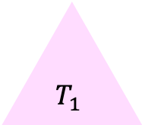
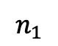
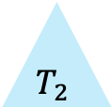
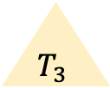
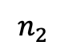
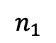
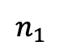
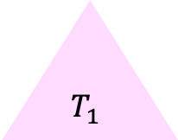
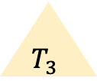
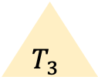
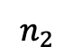
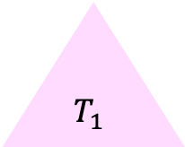
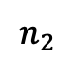
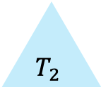
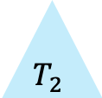
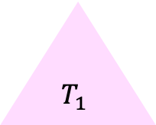
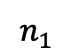
The 4 cases of rotations: generalization
$$n_{1}$$
$$n_{1}$$
$$n_{1}$$
$$n_{1}$$
$$T_{3}$$
$$T_{3}$$
$$T_{3}$$
$$n_{2}$$
$$n_{2}$$
$$n_{2}$$
$$T_{3}$$
$$n_{2}$$
$$T_{1}$$
$$T_{2}$$
$$T_{2}$$
$$T_{1}$$
$$T_{1}$$
$$T_{2}$$
$$T_{1}$$
$$T_{2}$$

Slide 94

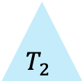
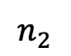
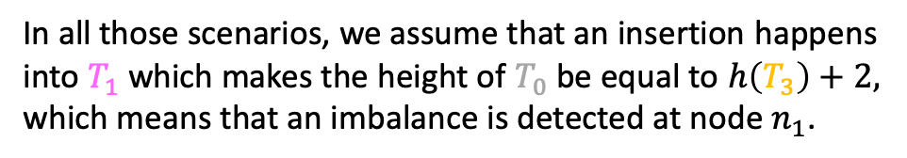
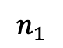
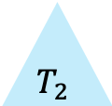
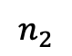
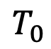
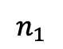

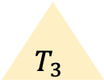
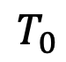
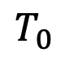

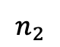
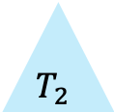
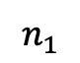
The 4 cases of rotations: generalization
$$n_{1}$$
$$n_{1}$$
$$n_{1}$$
$$n_{1}$$
$$T_{3}$$
$$T_{3}$$
$$T_{3}$$
$$n_{2}$$
$$n_{2}$$
$$n_{2}$$
$$T_{3}$$
$$n_{2}$$
$$T_{1}$$
$$T_{2}$$
$$T_{0}$$
$$T_{0}$$
$$T_{1}$$
$$T_{0}$$
$$T_{2}$$
$$T_{1}$$
$$T_{2}$$
$$T_{2}$$
$$T_{0}$$
$$T_{1}$$
In all those scenarios, we assume that an insertion happens into $T_{1}$ which makes the height of $T_{0}$ be equal to $h\left(T_{3}\right)+2,$ which means that an imbalance is detected at node $n_{1}$.

Slide 95
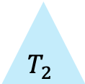
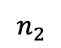

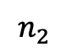
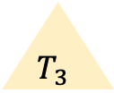
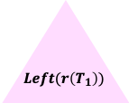








































The 4 cases of rotations: generalization
$$n_{1}$$
$$n_{1}$$
$$n_{1}$$
$$n_{1}$$
$$T_{3}$$
$$T_{3}$$
$$T_{3}$$
$$n_{2}$$
$$n_{2}$$
$$n_{2}$$
$$T_{3}$$
$$n_{2}$$
$$T_{2}$$
$$T_{1}$$
$$T_{2}$$
$$T_{1}$$
$$T_{2}$$
$$r\left(T_{1}\right)$$
$$T_{1}$$
$$T_{2}$$
$$T_{1}$$
$$R(n_{1})$$
$$LR(n_{1})$$
$$RL(n_{1})$$
$$L(n_{1})$$
$$n_{2}$$
$$r\left(T_{1}\right)$$
$$r\left(T_{1}\right)$$
$$n_{2}$$
$$n_{1}$$
$$n_{2}$$
$$n_{1}$$
$$n_{1}$$
$$n_{2}$$
$$T_{1}$$
$$T_{1}$$
$$T_{2}$$
$$T_{3}$$
$$n_{1}$$
$$T_{2}$$
$$Left(r\left(T_{1}\right))$$
$$Right(r\left(T_{1}\right))$$
$$T_{3}$$
$$T_{3}$$
$$Left(r\left(T_{1}\right))$$
$$Right(r\left(T_{1}\right))$$
$$T_{2}$$
$$T_{3}$$
$$T_{2}$$

Slide 96
Worksheet time!
Please switch to your worksheets and complete exercise 1 for us.

Slide 97
Deletions
Let’s revisit deletion in classic BSTs real quick.
Describe what will happen in this BST when we remove 13.
28
20
32
13
24
7
23
21

Slide 98
Deletions
Let’s revisit deletion in classic BSTs real quick.
Describe what will happen in this BST when we remove 13.
28
Easy case: Just replace with its only available subtree!
20
32
13
24
7
23
21

Slide 99
Deletions
Let’s revisit deletion in classic BSTs real quick.
Now what happens if we want to delete 20?
28
20
32
7
24
23
21

Slide 100
Deletions
Let’s revisit deletion in classic BSTs real quick.
Now what happens if we want to delete 20?
28
We have to find 20’s inorder successor.
20
32
7
24
23
21

Slide 101
Deletions
Let’s revisit deletion in classic BSTs real quick.
Now what happens if we want to delete 20?
28
We have to find 20’s inorder successor.
We copy the value of the inorder successor to 20.
21
32
7
24
23
21

Slide 102
Deletions
Let’s revisit deletion in classic BSTs real quick.
Now what happens if we want to delete 20?
28
We have to find 20’s inorder successor.
We copy the value of the inorder successor to 20
We recursively delete the inorder successor. This might trigger recursive deletions…
.
21
32
7
24
23
21

Slide 103

Deletions
Let’s revisit deletion in classic BSTs real quick.
Now what happens if we want to delete 20?
28
We have to find 20’s inorder successor.
We copy the value of the inorder successor to 20.
We recursively delete the inorder successor. This might trigger recursive deletions…
$2(n−1)$ links traversed in the worst case! (a degenerate right-leaning tree)
This is the hard case of deletion.
20
32
7
24
23

Slide 104
Deletions
We now come back to AVL world.
In addition to making sure we understand the classic BST deletion cases, we must also take care of two things:
Imbalances
Height updates if re-balancing occurs
Let’s look at some examples.

Slide 105
Deletion Examples
28
20
34
7
24
32
40
35
56
23

Slide 106
Deletion Examples
28
Let’s delete the key 7.
20
34
7
24
32
40
35
56
23

Slide 107
Deletion Examples
28
Let’s delete the key 7.
20
34
7
24
32
40
35
56
23

Slide 108
Deletion Examples
Imbalance detected here! :O
28
Let’s delete the key 7.
20
34
7
24
32
40
35
56
23

Slide 109
Deletion Examples
Imbalance detected here! :O
28
Let’s delete the key 7.
20
34
7
24
32
40
To rectify this imbalance, we will need a right-left rotation about 20!
35
56
23

Slide 110

Deletion Examples
Imbalance detected here! :O
28
Let’s delete the key 7.
20
34
7
24
32
40
To rectify this imbalance, we will need a right-left rotation about 20!
But how do we determine which rotation we need?
35
56
23

Slide 111

Deletion Examples
Imbalance detected here! :O
28
Let’s delete the key 7.
20
34
7
24
32
40
To rectify this imbalance, we will need either a left rotation about 20, or a right-left rotation about 20!
How do we determine which?
We have to check if our right subtree is left-heavy or right-heavy!
35
56
23
x

Slide 112
Deletion Examples
28
20
34
24
32
40
35
56
23
x
First, a right rotation about 24…

Slide 113
Deletion Examples
28
20
34
23
32
40
35
56
24
First, a right rotation about 24…

Slide 114
Deletion Examples
28
20
34
23
32
40
35
56
24
First, a right rotation about 24…
And then a left rotation about 23!

Slide 115
Deletion Examples
28
23
34
20
24
32
40
35
56
First, a right rotation about 24…
And then a left rotation about 23!

Slide 116
Deletion Examples
No imbalance detected at the root, so we’re good!
28
23
34
20
24
32
40
35
56
First, a right rotation about 24…
And then a left rotation about 23!

Slide 117
Deletion Examples
No imbalance detected at the root, so we’re good!
28
23
34
Take-home message #whatever: In deletions, when compared to insertions, if we delete a node from either one of the subtrees and this leads to an imbalance, we need to do a rotation that “shortens” the opposite subtree!
20
24
32
40
35
56
First, a right rotation about 24…
And then a left rotation about 23!

Slide 118
Deletion Examples
Now, let’s delete the key at the root, 28
28
23
34
20
24
32
40
35
56

Slide 119
Deletion Examples
Now, let’s delete the key at the root, 28.
1. Replace key of root with key of root’s inorder successor (32)
32
23
34
20
24
32
40
35
56

Slide 120
Deletion Examples
Now, let’s delete the key at the root, 28.
Replace key of root with key of root’s inorder successor (32)
Recursively delete inorder successor
32
23
34
20
24
32
40
35
56

Slide 121
Deletion Examples
Now, let’s delete the key at the root, 28.
Replace key of root with key of root’s inorder successor (32)
Recursively delete inorder successor
Fix imbalance detected at 34
32
23
34
20
24
40
35
56

Slide 122
Deletion Examples
Now, let’s delete the key at the root, 28.
Replace key of root with key of root’s inorder successor (32)
Recursively delete inorder successor
Fix imbalance detected at 34
How?
32
23
34
20
24
40
35
56

Slide 123

Deletion Examples
Now, let’s delete the key at the root, 28.
Replace key of root with key of root’s inorder successor (32)
Recursively delete inorder successor
Fix imbalance detected at 34
How?
Either way! (RL or L)
32
23
34
20
24
40
RL or L about 40 works!
35
56
Since right subtree fully balanced (balance = 0), either way works!

Slide 124
Worksheet time take 2
Please switch to your worksheets and complete exercise 2 for us.

Slide 125
Worksheet time take 3!
Please switch to your worksheets and complete exercise 3 for us.

